Slide 1



Understanding Attrition
Implementation of Machine Learning & Data Analytics for HR Management
Context
EDA
Features
Models
Results
Conclusions

Slide 2







Consulting Team
Adrian Ku
Rita Orvalho
Moritz Zoepffel
Roberta Troccoli
Alan Haro
Pedro Olivares
Sergio Ospina
Context
EDA
Features
Models
Results
Conclusions

Slide 3
CONTENT
1
Context
2
EDA
3
Feature Engineering
4
Models
5
Results
6
Conclusions
Context
EDA
Features
Models
Results
Conclusions

Slide 4

CONTEXT - Attrition
Voluntary
CONS
Involuntary
Retirements
High costs
Layoffs
Transfers
Main reasons
Loss of talent and knowledge
Personal health
Resignations
Decreased morale
Termination
Training gaps
Lower overall productivity
Context
EDA
Features
Models
Results
Conclusions
Notes:
“Whenever anyone ceases working for the company for any reason (voluntary resignations, layoffs, failure to return from a leave of absence) and is not replaced for a long time (if ever), that would be employee attrition.”

Slide 5
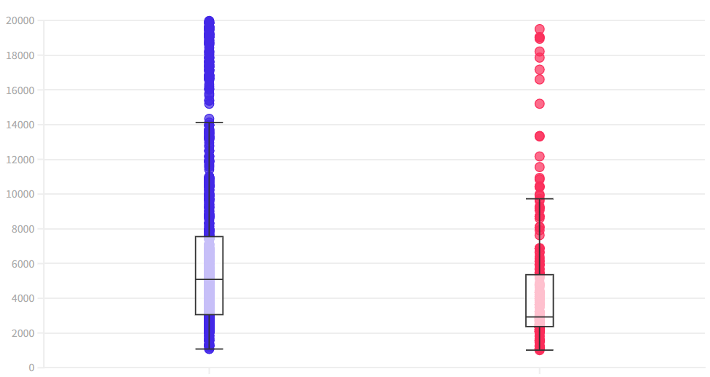
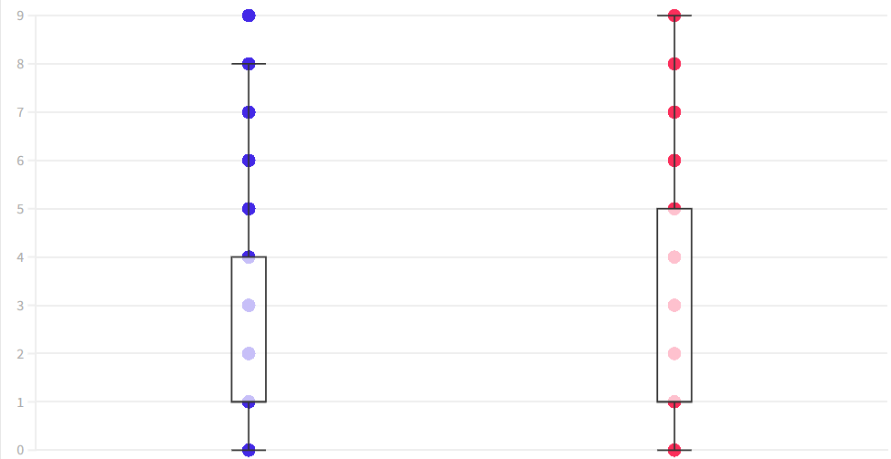
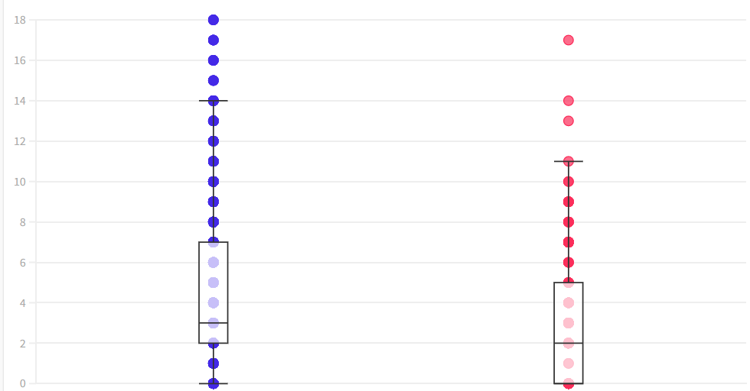
SITUATION - UNDERSTANDING THE DATA
Income Distribution
Number of Companies Worked
Years at Current Role
Employees with lower salaries produce higher attrition rates.
Employees with high rotation between companies have a higher attrition rate.
Employees with more years at current role have lower attrition rates.
Attrition
No
Yes
Context
EDA
Features
Models
Results
Conclusions

Slide 6
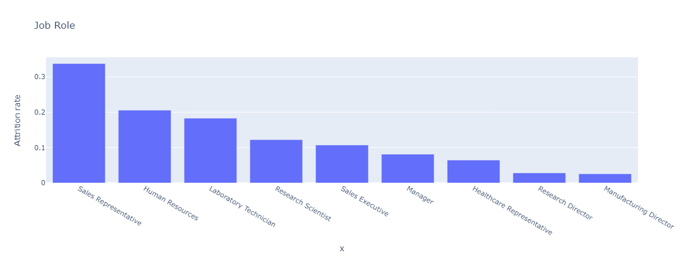
SITUATION - UNDERSTANDING THE DATA
Job Roles
Different Job Roles present different Attrition levels; being Sales Representative the one with highest rate.
Context
EDA
Features
Models
Results
Conclusions

Slide 7
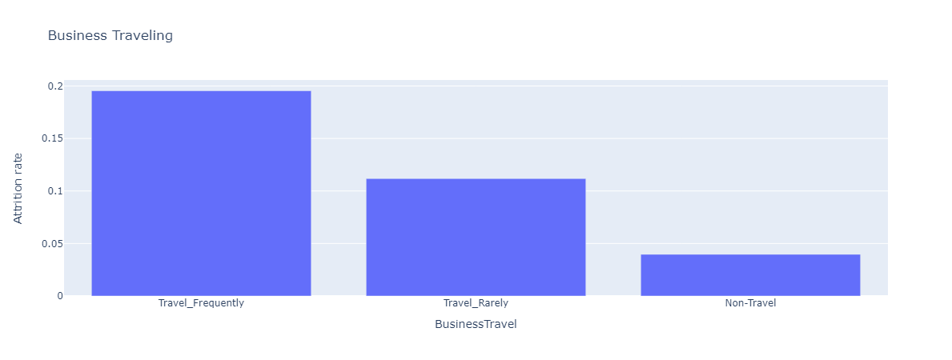
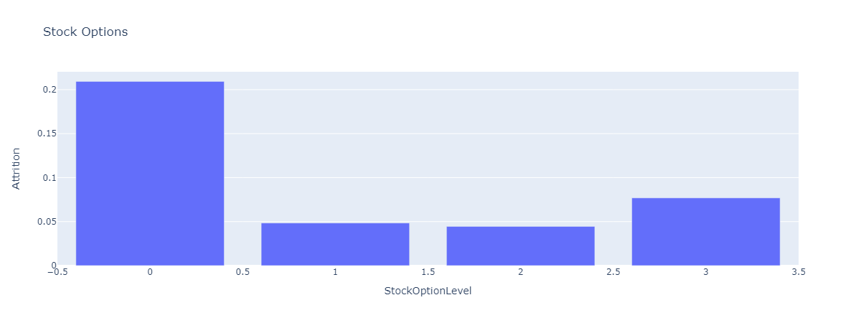
SITUATION - UNDERSTANDING THE DATA
Business Traveling
Stock Options
Traveling Frequency
Stock Option Level
Employees that travel frequently have a much higher incidence of attrition.
Employees with NO stock options have a much higher incidence of attrition.
Context
EDA
Features
Models
Results
Conclusions

Slide 8
FEATURE ENGINEERING
Unnecessary data
Categorical
Numerical
Remove data that is irrelevant for our model prediction.
Since we are facing a classification problem, we applied One-hot encoding- a method that converts labels into numbers.
For quantifiable characteristics, Standard Scaling method has been applied. It deals with the magnitudes.
Context
EDA
Features
Models
Results
Conclusions
Notes:
Here we will mention that we removed variables which had the same value repeated OR did not vary too much between Attrition (1 or 0)
(ID , 18y)
We will mention how we handle each type of variable (and what they are).

Slide 9
IMPACT OF PREDICTIONS
Prediction | Outcome | Result
Attrition | Attrition | Actions to keep employee
Attrition | No Attrition | Wrong allocation of resources
No Attrition | No Attrition | Nothing happens
No Attrition | Attrition | Loose employees
TP
FP
TN
FN
Context
EDA
Features
Models
Results
Conclusions

Slide 10
IMPLEMENTED MODELS
Cross validation / Random search
Models / Score Methods
ROC-
AUC
F-1
Model performance
Random Forest
0.855
0.092
Hyperparameters’ optimization
Logistic Regression
0.854
0.446
Class Weights - Balancing Data
Support Vector Machines
0.833
0.000
Extreme Gradient Booster
0.813
0.396
K Nearest Neighbors
0.751
0.000
Context
EDA
Features
Models
Results
Conclusions
Notes:
Cross-validation to evaluate the performance of the model
Random search to optimize the hyperparameters of the models
Together they ensure that the model's performance is evaluated using an unbiased estimate.

Slide 11
MAIN VARIABLES AFFECTING ATTRITION
INCREASE ATTRITION
DECREASE ATTRITION
No Stock Options
Low Job Involvement
Poor Work-Life Balance
Marketing Background
Low Satisfaction in work environment
Few Business Traveling
High Performance Rating
Low Work Overtime
High Job Positions
Higher Salaries
Context
EDA
Features
Models
Results
Conclusions
Notes:
Increase:
StockOptionLevel_0 : positive coefficient, indicating that employees with zero stock options are more likely to leave the company. This could be because employees who have invested in the company through stock options are more committed to the organization and its success.
JobInvolvement_1: positive coefficient, indicating that employees who are less involved in their jobs are more likely to leave the company. This could be because employees who are more engaged in their work are more satisfied and committed to their jobs.
WorkLifeBalance_1: This feature has a positive coefficient, indicating that employees who report a better work-life balance are less likely to leave the company. This could be because employees who feel they have a good balance between work and personal life are more satisfied and committed to their jobs.
EducationField_Marketing: positive coefficient, indicating that employees with a marketing education are more likely to leave the company. This could be due to various reasons, such as job opportunities in the marketing industry or dissatisfaction with the job role.
EnvironmentSatisfaction_1: This feature has a positive coefficient, indicating that employees who report a low level of satisfaction with their work environment are more likely to leave the company. This could be due to various reasons, such as a lack of resources or support, leading to lower job satisfaction.
Decrease:
BusinessTravel_Non-Travel: This feature has a negative coefficient, indicating that employees who do not travel for business are less likely to leave the company. This could be because business travel can be stressful and disrupt work-life balance, leading to higher attrition rates.
PerformanceRating_3: This feature has a negative coefficient, indicating that employees who receive a higher performance rating are less likely to leave the company. This could be because employees who feel recognized and rewarded for their contributions are more likely to stay with the company.
OverTime_No: negative coefficient, indicating that employees who do not work overtime are less likely to leave the company. This could be because working overtime can lead to burnout and dissatisfaction, leading to higher attrition rates.
JobLevel_2 : This feature has a negative coefficient, indicating that employees at a higher job level are less likely to leave the company. This could be because higher-level employees have invested more time and effort into their careers and are more committed to the organization.
PercentSalaryHike (7): This feature has a negative coefficient, indicating that employees who receive a higher salary hike are less likely to leave the company. This could be because higher salaries and rewards motivate employees and make them feel valued by the organization, leading to higher job satisfaction and retention.

Slide 12
ACTIONS
If… |  | Offer…
No Stock Options |  | Increase salary, bonuses, competitive benefits (retirement, healthcare…)
Low Job Involvement |  | Additional training, team building, coaching options
Poor Work-Life Balance |  | Increase flexibility, remote work, adjust working hours, wellness programs
Marketing Background |  | Create a clear career path, benchmark analysis of other marketing companies
Low satisfaction in work environment |  | Team building activities, mental health check, feedback sessions
Context
EDA
Features
Models
Results
Conclusions
Notes:
We adopted a STAR approach:
we identified the situation (started to understand the data we had, why they were leaving, their job roles, their interactions with the organization etc…)
Task: identify the specific task at hand, which is to lower attrition rates among these employees. Develop a plan that takes into account their specific needs and motivators (top 5 features positive and negative correlated with attrition)
Action: the one in this slide
Results: (next slide)

Slide 13
NEXT STEPS
12.3%
Attrition
*Estimated rate for next period
~10%
Increase employee feedback
Implement retention metrics in relation with observed variables
Integrate recruiting, HR and C-level
Track actions and results over next period to understand positive impact on Attrition Levels
Attrition
EoY Target
Context
EDA
Features
Models
Results
Conclusions
Notes:
Results: , we predict the attrition will be “__%”, we aim to lower it to “__%” and we will track the results of our actions to evaluate their effectiveness in lowering attrition rates. We will use more employee feedback and retention metrics to measure progress and identify areas of improvement.

Slide 14
THANKS!
Do you have any questions?
consulting@dynamite.com
+34 626 778 682
dynamiteconsulting.com
Context
EDA
Features
Models
Results
Conclusions

